Slide 1
IBM University Engagement Project Submission
“Exploring the Power of Agentic AI with IBM Granite and IBM Bob”

Slide 2

Project Tile – Fitness Buddy
Domain of Project – Healthcare & Fitness / HealthTech
Student Name | Recent Passport Photo | Email ID | Mobile number [WhatsApp]
GULSHAN KUMAR |  | gulshanrajput2210@gmail.com | 8287289235

Slide 3
Problem Statement -
Fitness Buddy
The challenge - In today’s fast-paced world, many individuals struggle to maintain a healthy lifestyle due to lack of personalized guidance, time constraints, and inconsistent motivation. Traditional fitness solutions often require expensive subscriptions, in-person consultations, or rigid schedules that don't adapt to personal preferences or daily routines.
There is a growing need for an accessible, friendly, and intelligent virtual assistant that can provide on-demand fitness advice, healthy lifestyle suggestions, and basic nutrition guidance—all tailored to individual needs and available at any time.
Fitness Buddy aims to solve this problem by offering a conversational, AI-powered health and fitness coach that can:
Recommend home workouts and routines based on user input.
Provide motivational tips and daily fitness inspiration.
Suggest simple, nutritious meal ideas.
Encourage habit-building and consistency.

Slide 4
Proposed Solution -
Proposed Solution: We propose to develop Fitness Buddy, an AI-powered virtual fitness and wellness assistant that helps users maintain a healthy and active lifestyle. The platform will provide personalized home workout recommendations, simple and nutritious meal suggestions, daily motivational tips, and habit-building guidance based on the user's fitness goals, fitness level, preferences, and available time.
The web application will be developed using IBM Bob, providing a simple and user-friendly interface for users to interact with the Fitness Buddy assistant. IBM watsonx.ai and IBM Granite will power the AI capabilities and generate personalized fitness, wellness, and nutrition recommendations. IBM Watson Orchestrate will be used to coordinate AI-powered tasks and automate different activities within the application. IBM Cloud Lite services will support the application's cloud-based functionality and deployment.
The main goal of Fitness Buddy is to make fitness guidance simple, personalized, accessible, and easy to follow, helping users stay motivated, build healthy habits, and maintain consistency in their fitness journey.

Slide 5
Technology Used
IBM Bob platform -For designing and orchestrating multi-agent workflows visually
IBM Grainte model - for eg – ibm-granite-3-2-8b – For natural language understanding, reasoning, and personalization
IBM Cloud – It provides the infrastructure to build, deploy, and scale the Nutrition Agent efficiently. IBM Cloud enables a reliable, secure, and scalable environment for deploying the Nutrition Agent.
IBM Watsonx.ai - For model deployment, embeddings, and AI governance

Slide 6
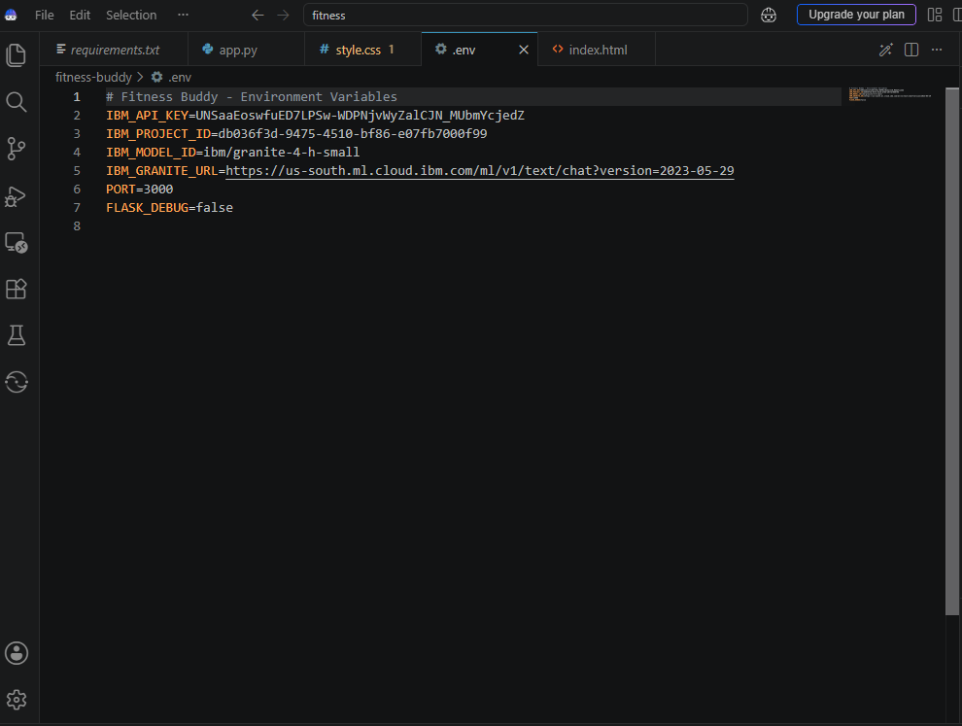
Required Files created using IBM bob -
App.py
Requirements.txt
Style.css
.env
Index.html

Slide 7
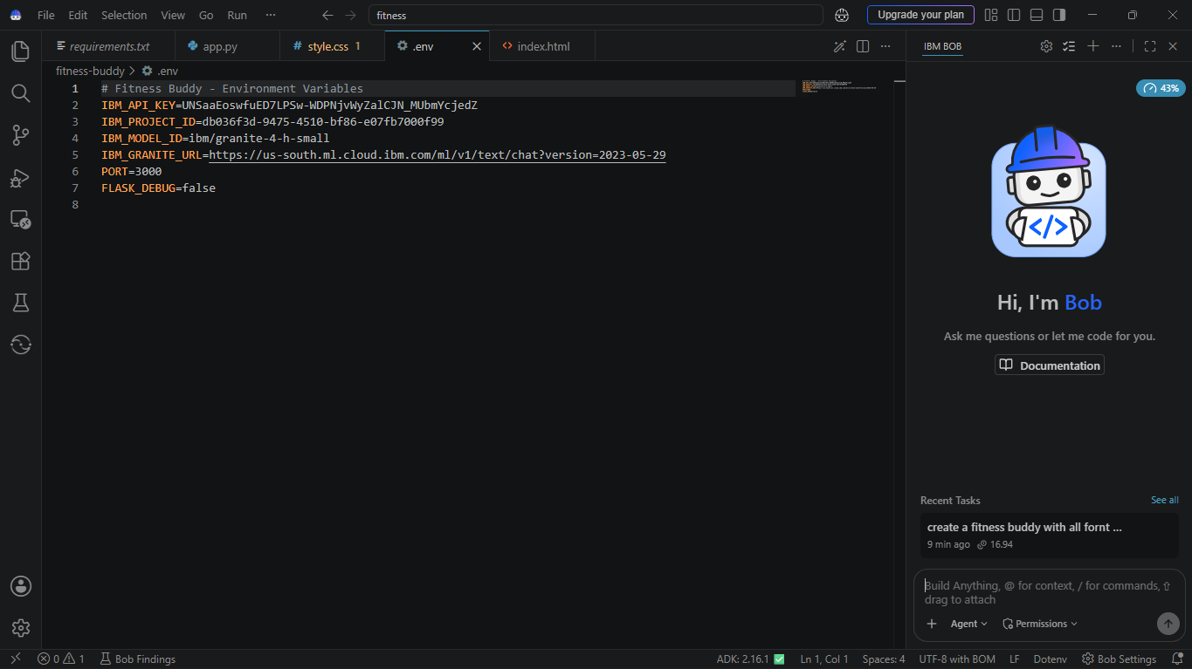
IBM Bob Screenshots:

Slide 8
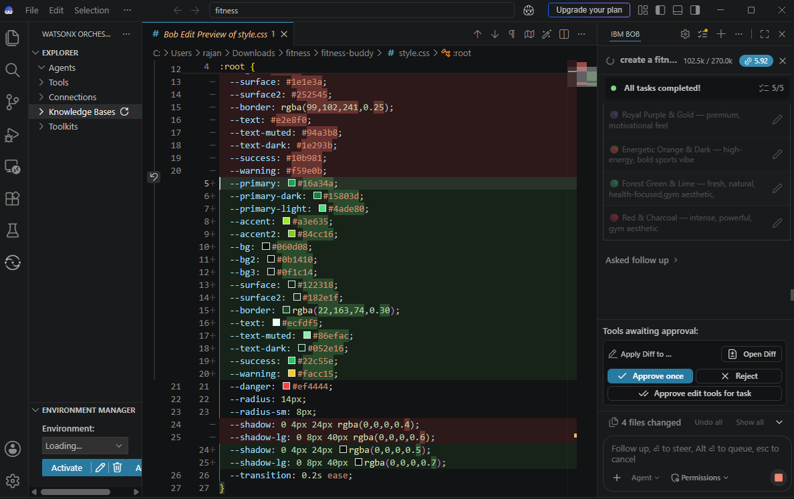

Slide 9
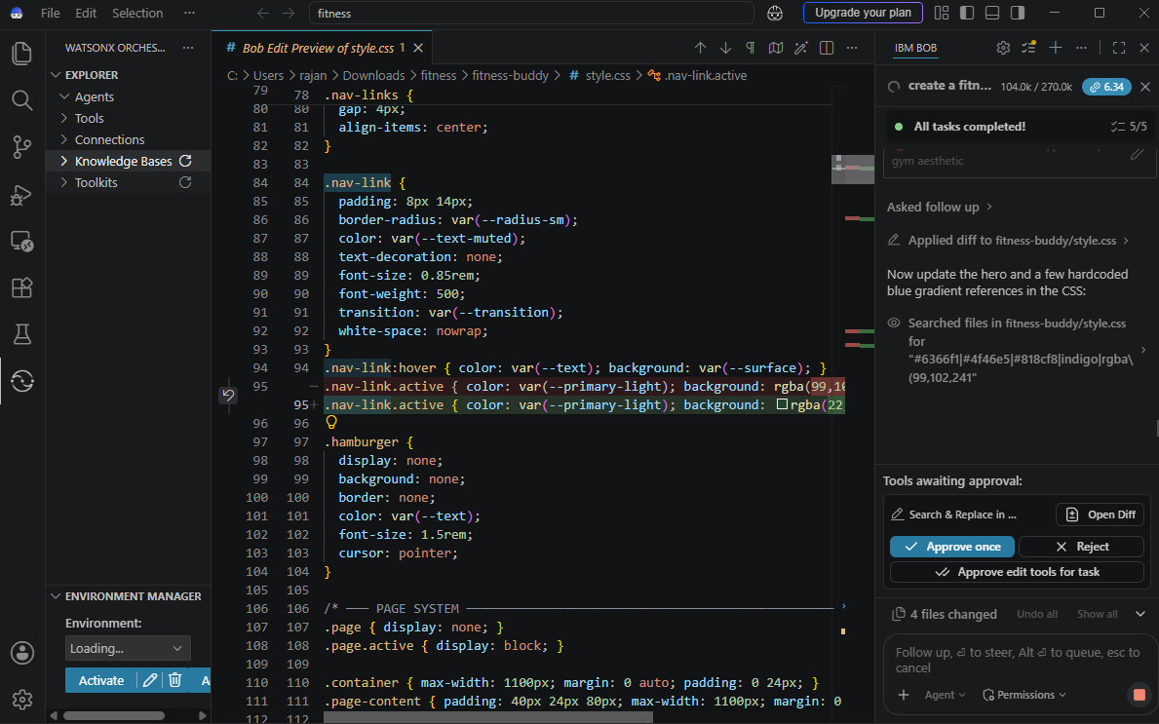

Slide 10
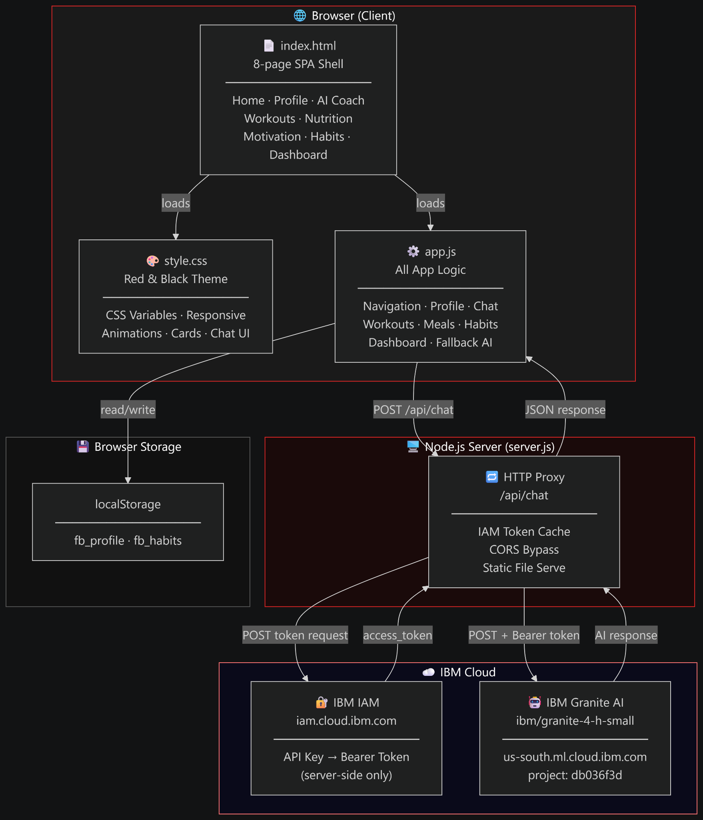
Architecture blueprint for IBM bob:

Slide 11

Role of Agentic AI in the solution
Role of Agentic AI in Fitness Buddy
Agentic AI is the core of Fitness Buddy, acting as a personalized virtual fitness and wellness coach. It understands the user's fitness goals, fitness level, preferences, and daily needs to provide suitable recommendations instead of giving only fixed information.
The AI agent can generate personalized workout routines, healthy meal suggestions, motivational tips, lifestyle guidance, and habit-building recommendations. Users can interact with it through a conversational interface and receive guidance based on their specific requirements.
IBM Granite provides natural language understanding and personalized responses, while IBM watsonx.ai supports the AI capabilities. IBM Watson Orchestrate helps coordinate different AI tasks and workflows, and IBM Bob is used to build and organize the application.
Overall, Agentic AI makes Fitness Buddy interactive, personalized, adaptive, and goal-oriented, helping users stay motivated and consistent with their healthy lifestyle.

Slide 12
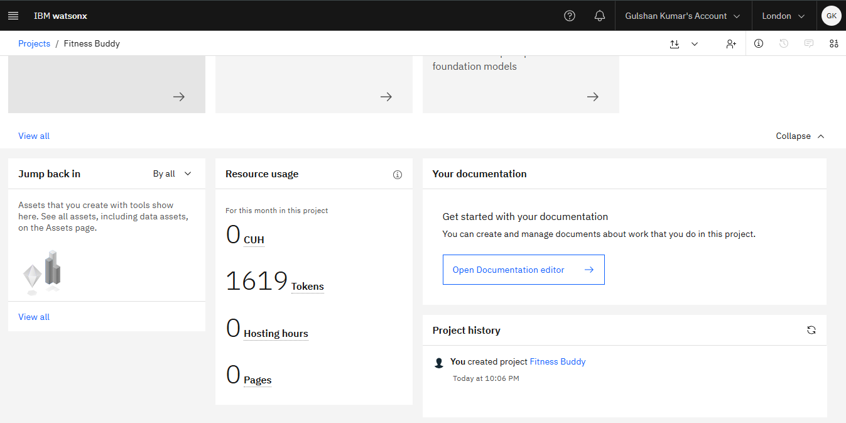
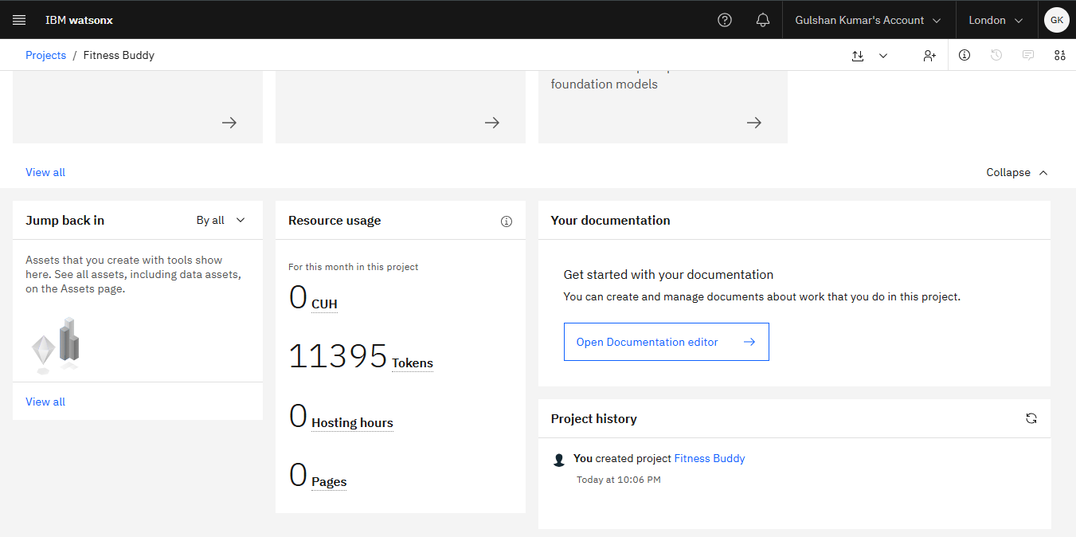
Token Usage
11,761 token are used
Before Prompt
After the Prompt
·
·

Slide 13
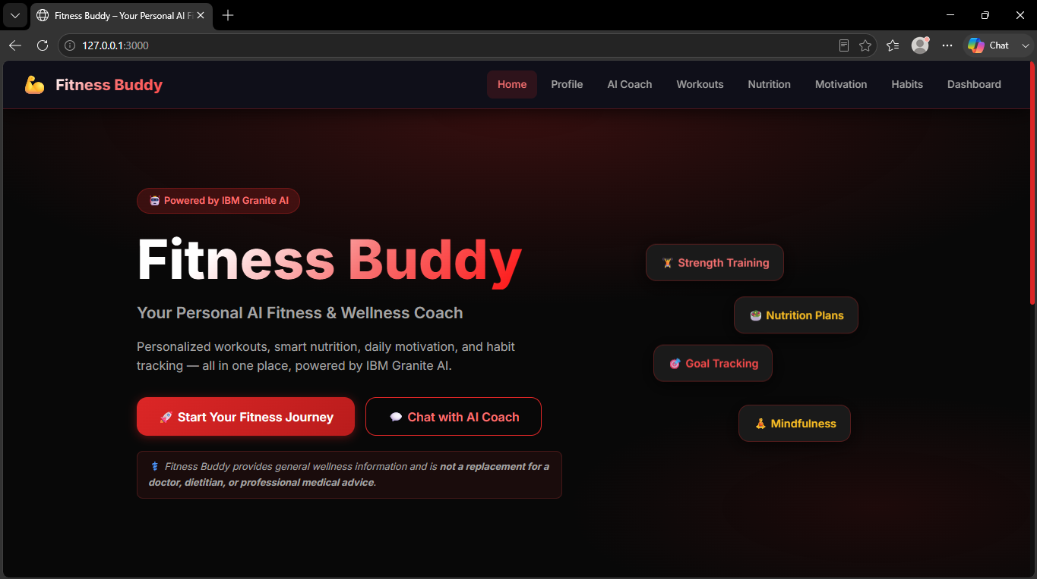
Project Output Screenshot
Please put IBM Bob output screenshots with 2-3 prompts.
You can take 2-3 more slides for each screenshot
·
·
·

Slide 14
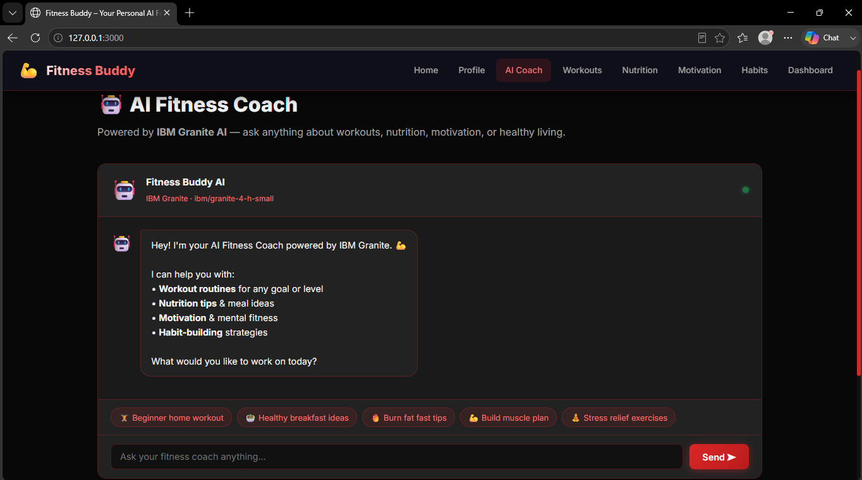
Project Output Screenshot
Please put IBM Bob output screenshots with 2-3 prompts.
You can take 2-3 more slides for each screenshot
·
·
·

Slide 15
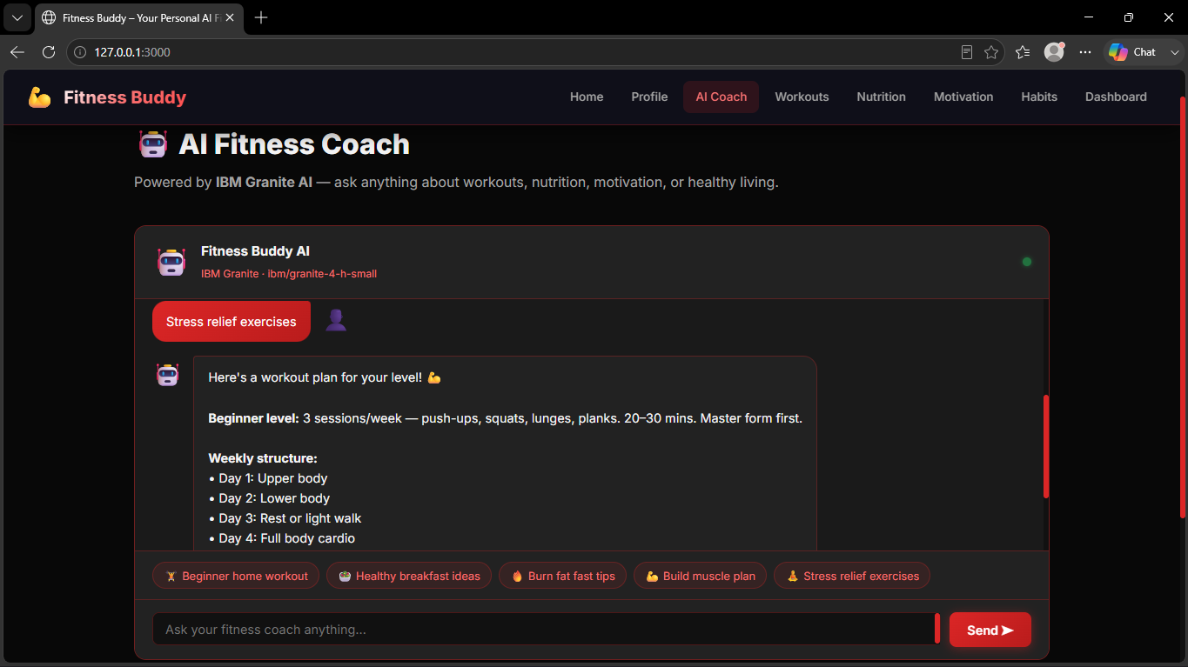
Project Output Screenshot
Please put IBM Bob output screenshots with 2-3 prompts.
You can take 2-3 more slides for each screenshot
·
·
·

Slide 16
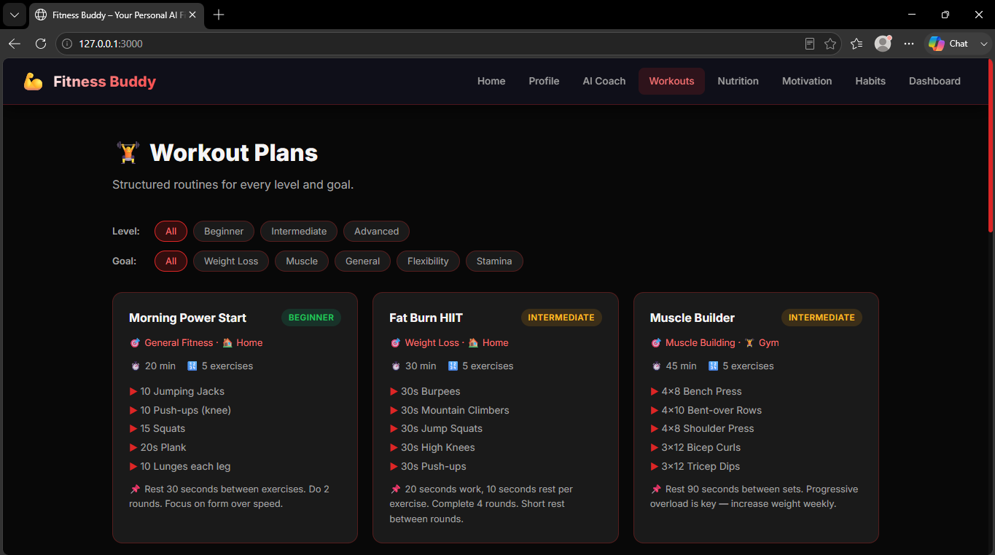
Project Output Screenshot
Please put IBM Bob output screenshots with 2-3 prompts.
You can take 2-3 more slides for each screenshot
·
·
·

Slide 17
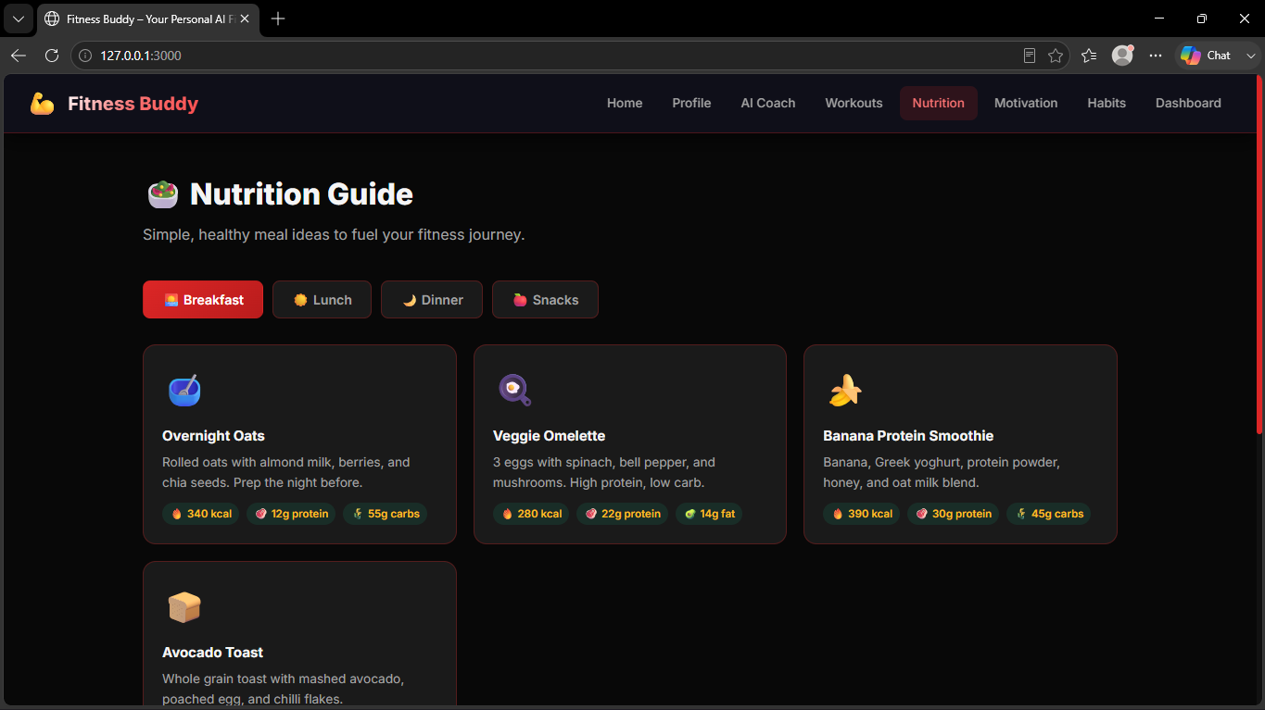
Project Output Screenshot
Please put IBM Bob output screenshots with 2-3 prompts.
You can take 2-3 more slides for each screenshot
·
·
·

Slide 18
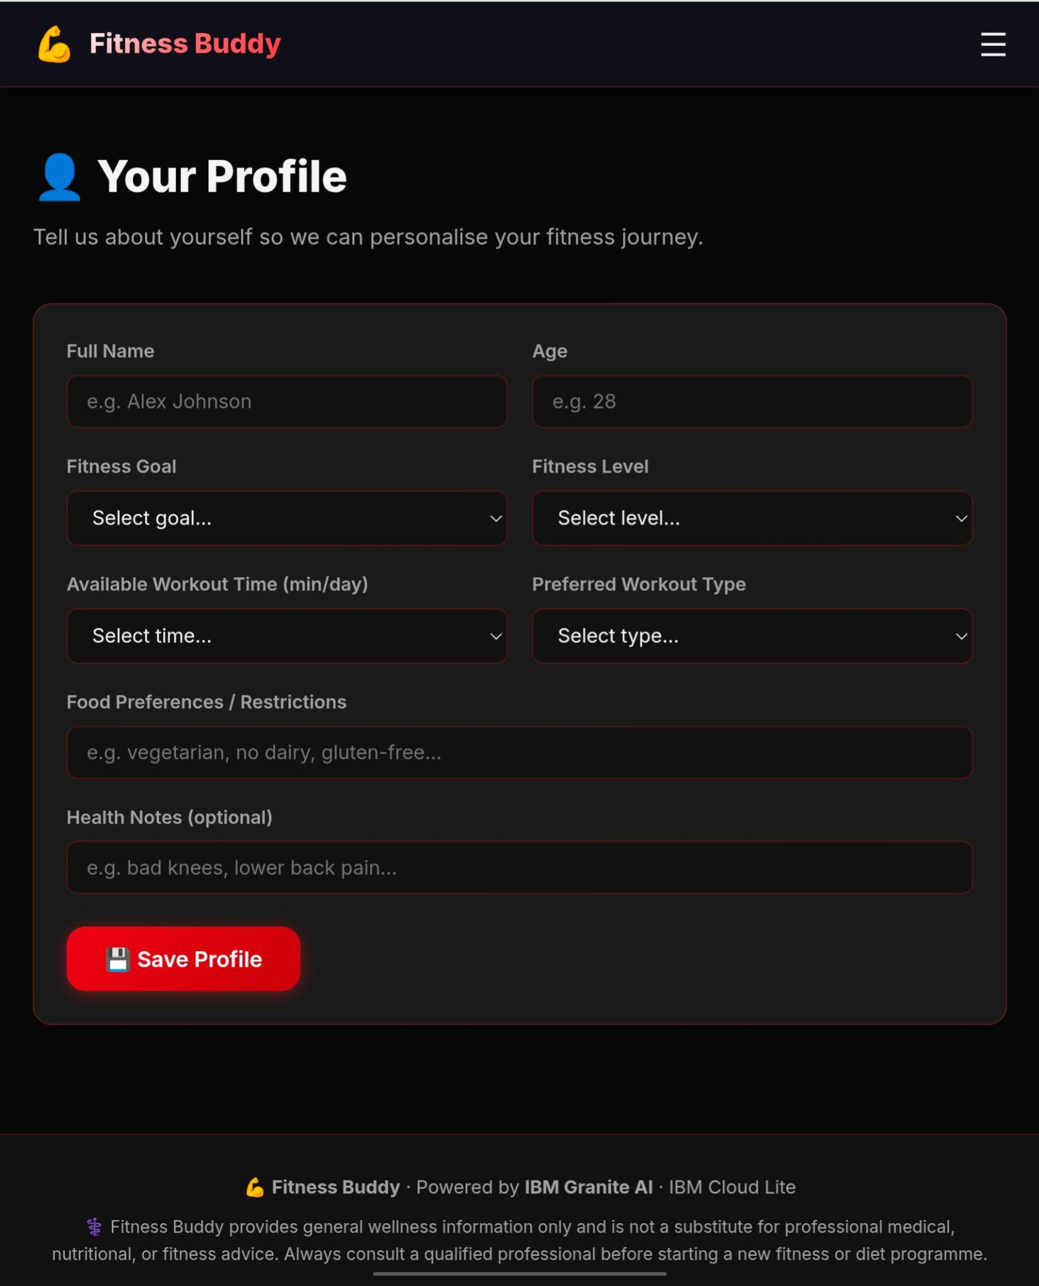
Project Output Screenshot
Please put IBM Bob output screenshots with 2-3 prompts.
You can take 2-3 more slides for each screenshot
·
·
·

Slide 19
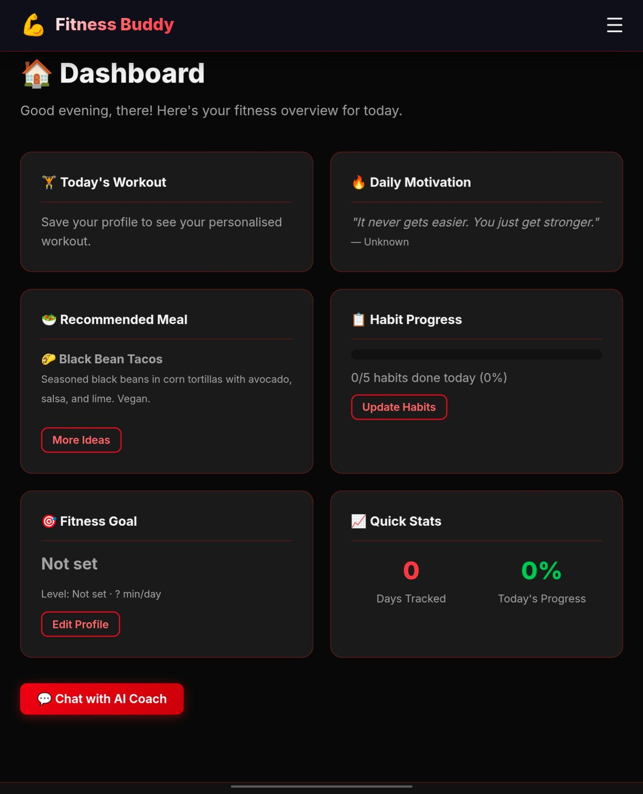
Project Output Screenshot
Please put IBM Bob output screenshots with 2-3 prompts.
You can take 2-3 more slides for each screenshot
·
·
·

Slide 20
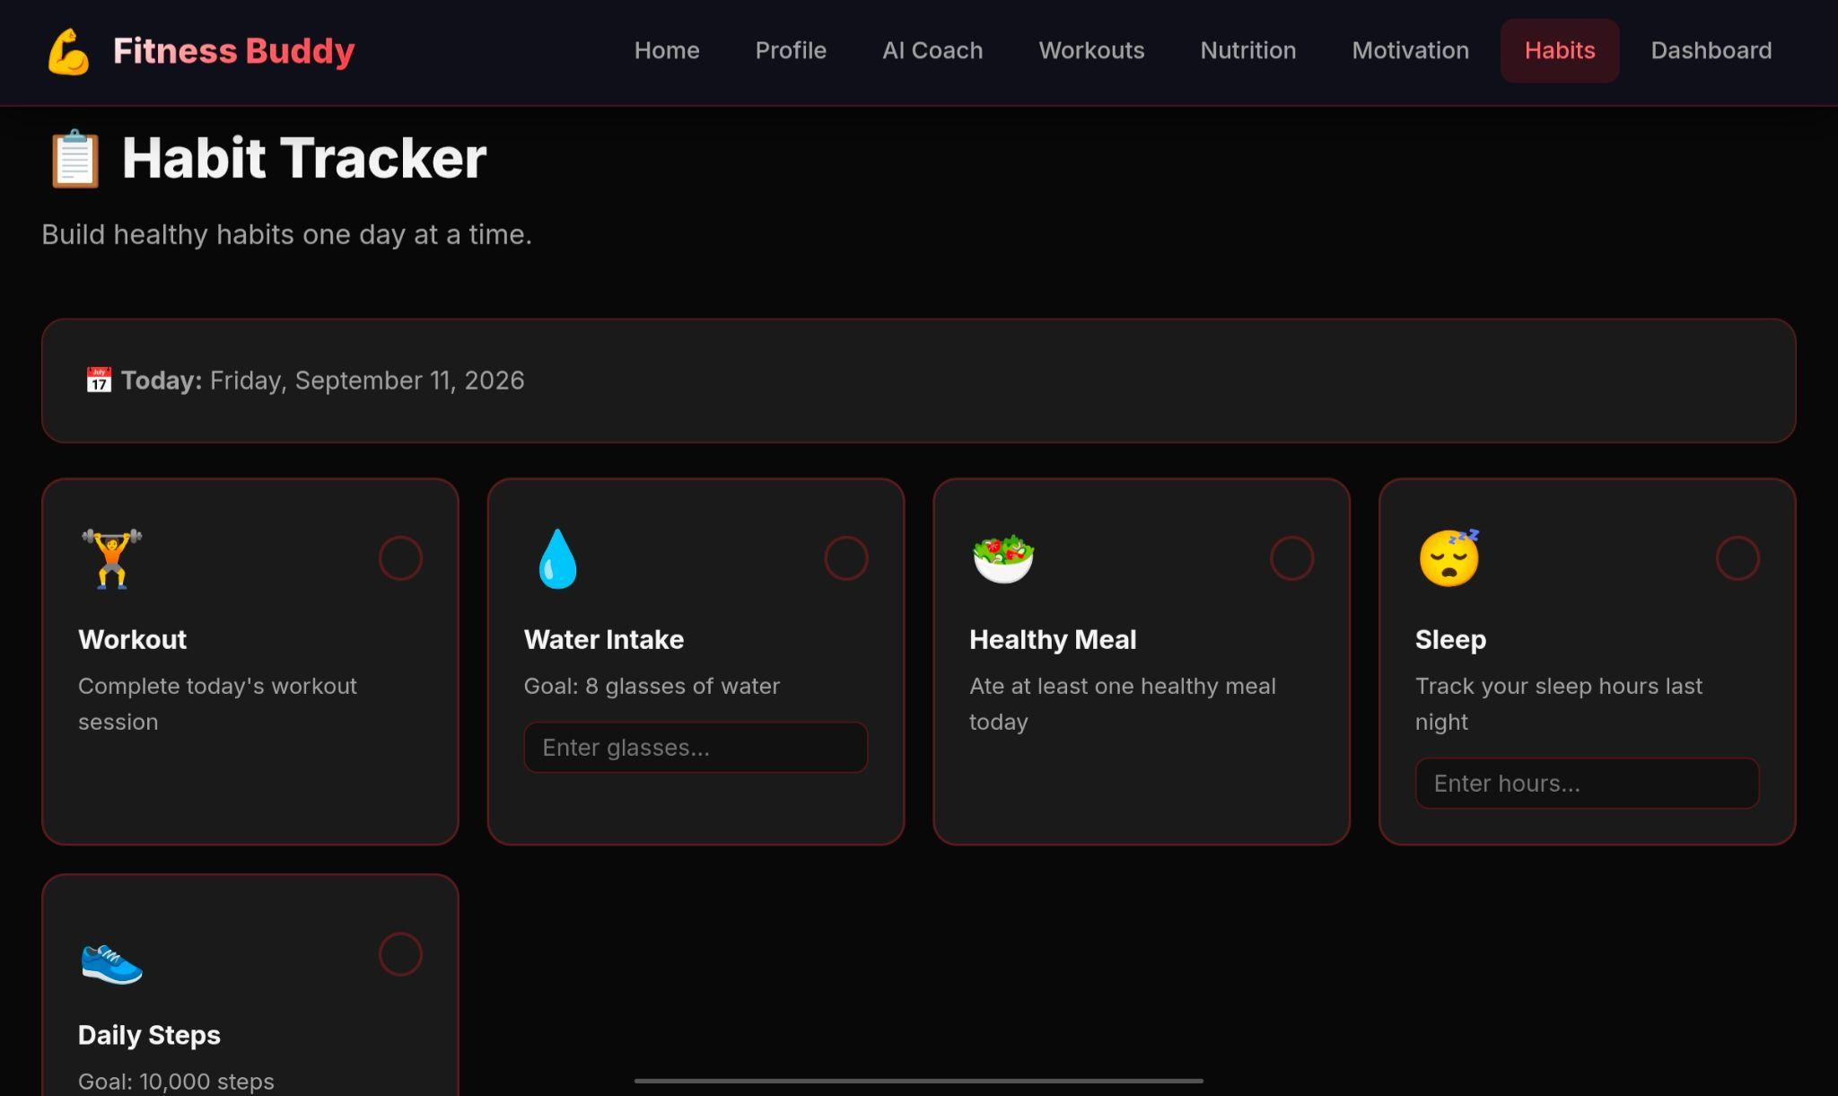
Project Output Screenshot
Please put IBM Bob output screenshots with 2-3 prompts.
You can take 2-3 more slides for each screenshot
·
·
·

Slide 21
Novelty and Uniqueness
The uniqueness of Fitness Buddy lies in its ability to provide personalized fitness and wellness guidance through an AI-powered conversational agent rather than offering only fixed workout plans or general health information. The system understands the user's fitness goals, fitness level, preferences, and available time to provide more relevant recommendations.
The solution combines workout guidance, nutrition suggestions, motivation, and habit-building support in one platform. Its use of Agentic AI with IBM Granite, watsonx.ai, and Watson Orchestrate enables the system to intelligently handle different user requests and coordinate tasks to provide a more interactive experience.
Unlike traditional fitness applications that may require expensive subscriptions or personal trainers, Fitness Buddy provides accessible and on-demand guidance through a simple web-based platform. The combination of AI personalization, conversational interaction, and multiple wellness features in a single assistant makes the solution practical, user-friendly, and suitable for people with different lifestyles and fitness goals.
It brings workouts, healthy meal suggestions, motivation, and habit tracking together in one AI-powered platform. Users can simply chat with the assistant and get quick, personalized guidance. The use of IBM Granite, watsonx.ai, and Watson Orchestrate makes the system more interactive and capable of handling different fitness and wellness tasks.

Slide 22
Git Hub Link
https://github.com/Gulshan-web/Fitness-Buddy
·
·

Slide 23
Future Scope
Smartwatch & Fitness Tracker Integration – Track steps, heart rate, calories, sleep, and daily activity.
Personalized Fitness Plans – Create long-term workout plans based on the user's progress.
Personalized Nutrition Plans – Provide meal recommendations based on goals and food preferences.
Voice AI Coach – Allow users to interact with the Fitness Buddy using voice while exercising.
Progress Tracking – Monitor fitness progress and provide regular reports.
Smart Reminders – Send reminders for workouts, water intake, meals, and healthy habits.
RAG Integration – Use a reliable fitness and nutrition knowledge base to provide more accurate information.
Advanced AI Personalization – Continuously improve recommendations based on user activity and progress.
Mobile Application – Expand Fitness Buddy into Android and iOS applications.
Complete Wellness Platform – Integrate fitness, nutrition, motivation, and habit tracking into one intelligent platform.
·

Slide 24
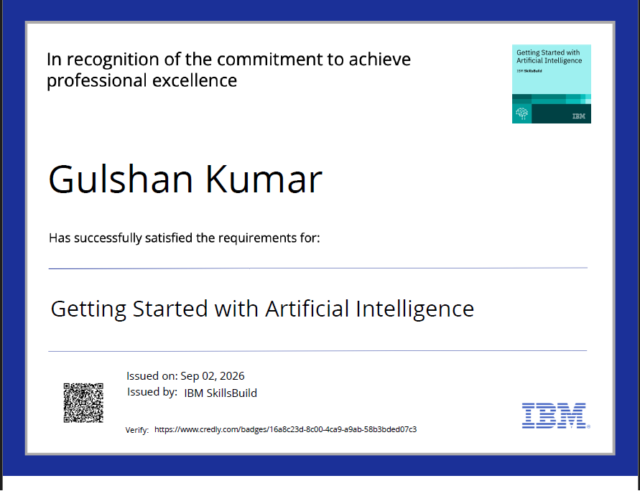
Certificates Earned:

Slide 25
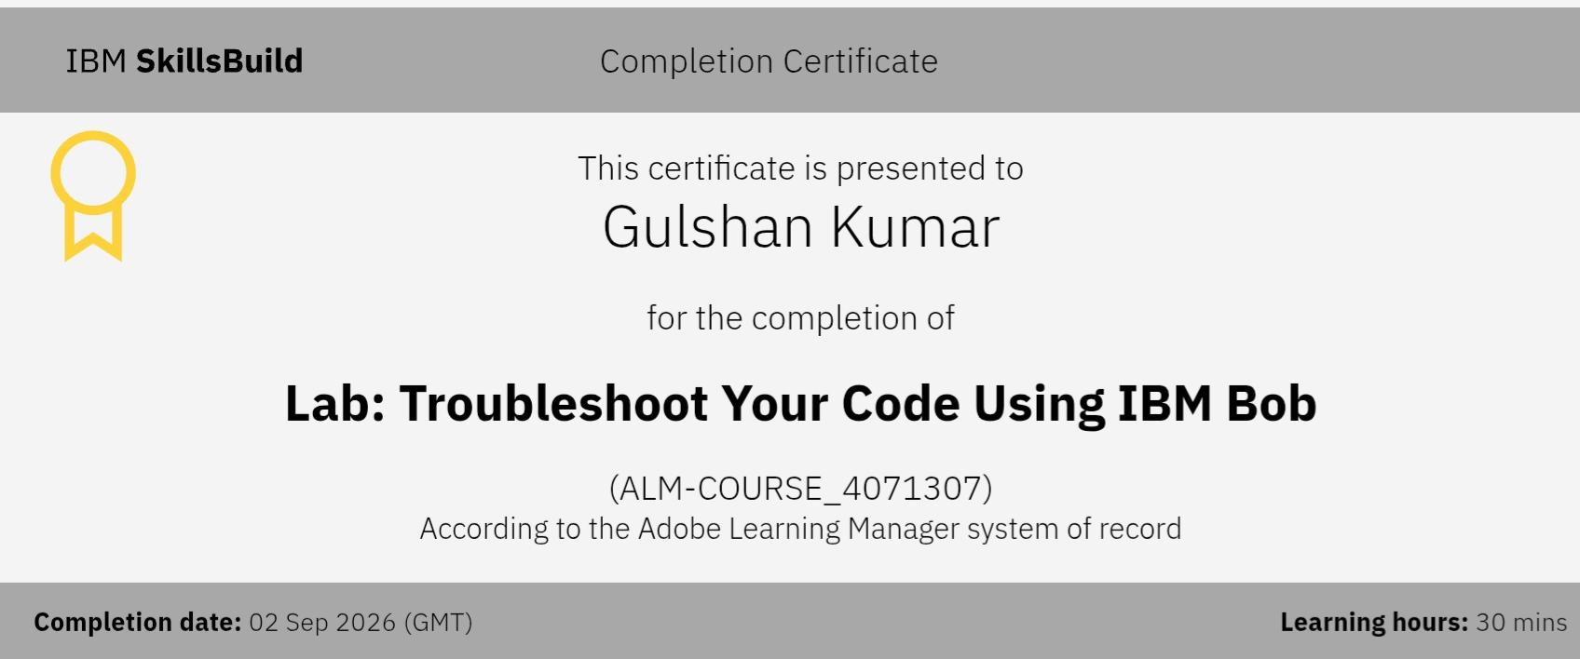
Certificates Earned:​

Slide 26


